Slide 1
Aim:
To manage customer churn
To implement Semantic driven subtractive clustering algorithm in hadoop environment in MapReduce framework.

Slide 2
Objective:
As market competition intensifies, customer churn management is increasingly becoming an important means of competitive advantage for companies.
When dealing with big data in the industry, existing churn prediction models cannot work very well. So, we had proposed a new model.

Slide 3
Literature Survey:
AFS can deal with the preferences attributes, which reflects the preference extent of a customer influenced by social networking.
In case of distributed k-means algorithm, the clustering results are likely to be imprecise if the initial parameters are valued improperly.

Slide 4
Customer churn prediction in telecommunications:
Logistic Regressions is a widely used statistical modeling technique for discriminative probabilistic classification.
Decision Trees is a method known as ‘‘divide and conquer’’ is applied to construct a binary tree.
Naive Bayes classifier calculates the probability that a given input sample belongs to a certain class.
A linear classifier maps a feature space X into a set of class labels Y by a linear combination function.

Slide 5
Semantic Clustering Method:
The mountain method becomes computationally inefficient when applied to high dimensional data.
An improved version of the mountain method, referred to as the subtractive method, in which each data point is considered as a potential cluster centroid.

Slide 6


The mountain function at a data point xi is defined as
where α is a positive constant.
The modified mountain function used to find subsequent cluster centroids is defined as

Slide 7
Simplified Data Processing on Large Clusters:
Users specify a map function that processes a key/value pair to generate a set of intermediate key/value pairs, and a reduce function that merges all intermediate values associated with the same intermediate key.
Programs written in this functional style are automatically parallelized and executed on a large cluster of commodity machines.
A typical MapReduce computation processes large amount of data on thousands of machines.
Department of IT

Slide 8
MapReduce Model of Hadoop:
MapReduce is a parallel programming framework for processing the large scale data set with numerous machines.
MapReduce model interleaves sequential and parallel computation.
Specifically, the reduce tasks cannot start until all map tasks finish, while in map and reduce phase, tasks are parallel.
All map tasks are independent from each other and there is no communication among them, so do reduce tasks.
Department of IT

Slide 9
System Architecture
Data and Fuzzy concept
AFS
SDSCM
τ1, τ2
SCM
Centroids
K-means
Clustering Results

Slide 10

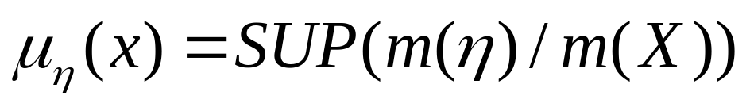
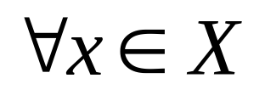
SDSCM Algorithm
Step 1:
According to the fuzzy concept ƞ given by the user, compute the membership of
Input:
Telecom Dataset
Output:
Key : xsum
Value : µ

Slide 11
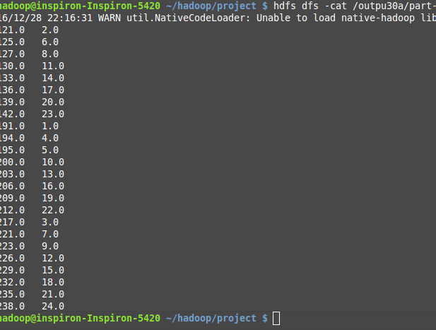
Screen Shot:

Slide 12

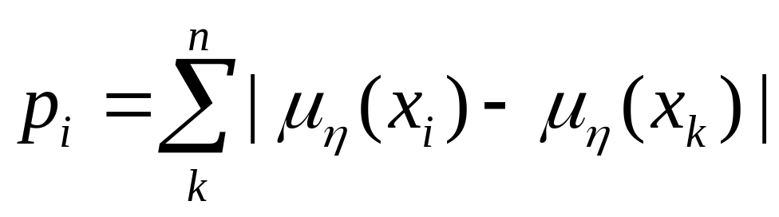

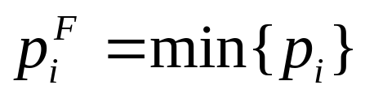
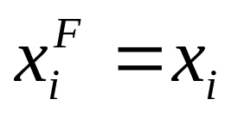
Step 2:
Compute the sum of absolute differences of
Step 3:
Select the minimum value of as the first cluster centroid

Slide 13
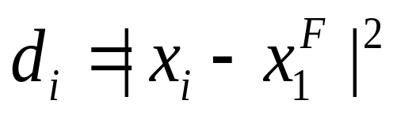
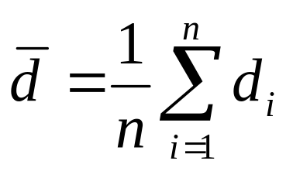


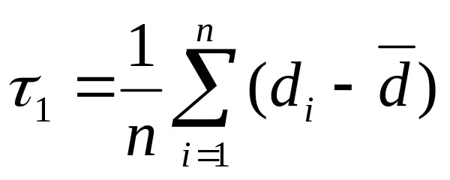
Step 4:
1. Compute the euclidean distance between the first cluster centroid and other data points.
2. Average of ,
3. Calculate the neighbor radius

Slide 14
Input:
Membership value (µ)
Output:
Key : τ1
Value : τ2

Slide 15
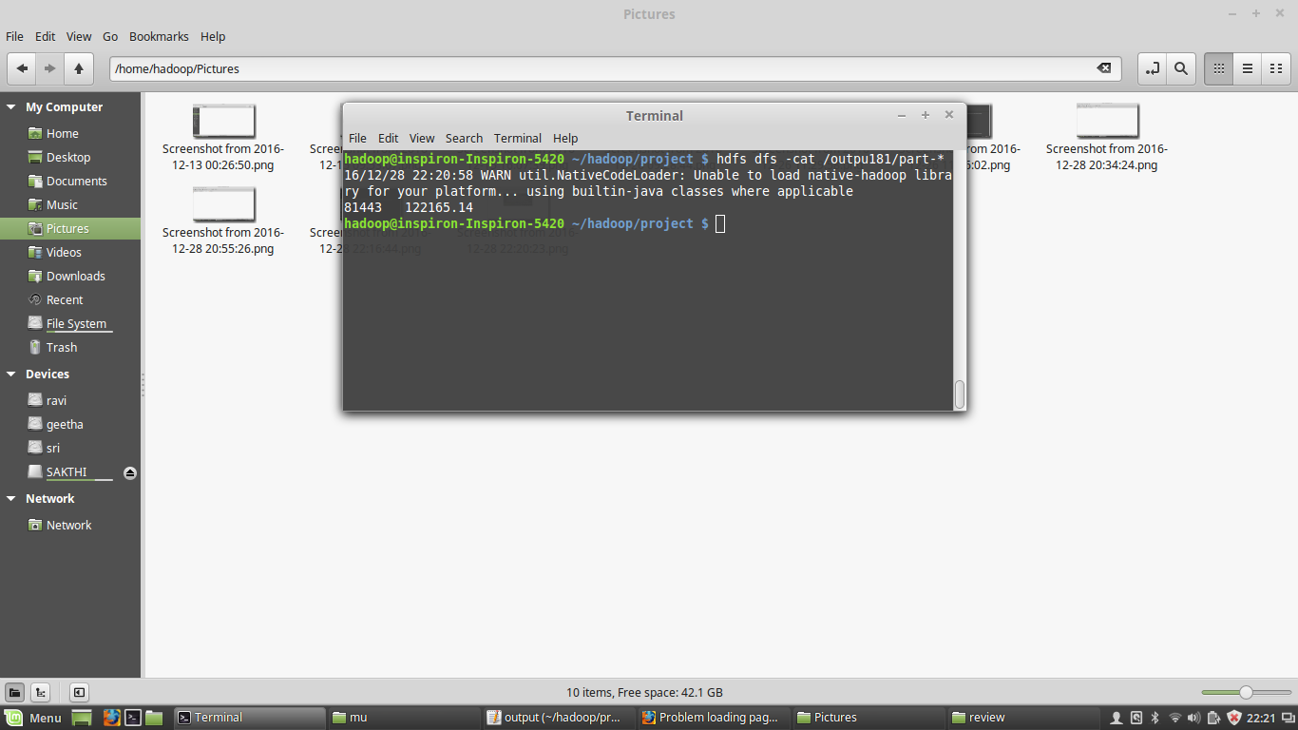
Screen Shot:
Department of IT

Slide 16

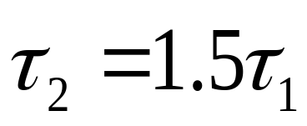

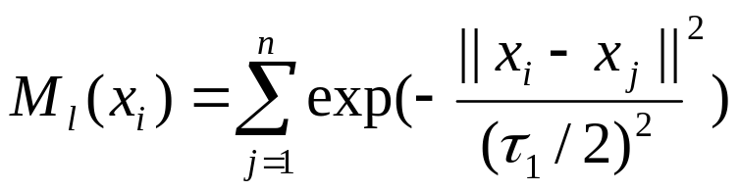
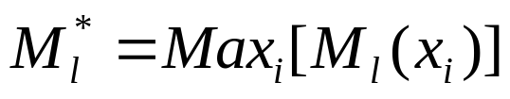
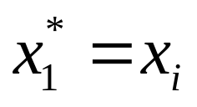
Step 5:
Set the weight coefficient
Step 6:
Let l=1 and compute the mountain function of
Step 7:
Select the maximum mountain function
Make the first cluster centroid

Slide 17
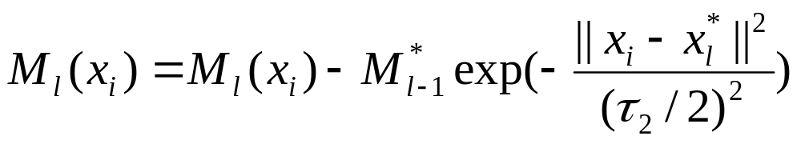

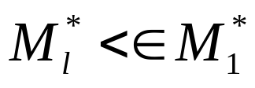
Step 8:
Let l=l+1, and update the mountain function of each data vector
Step 9:
Select the data associated with larger to be the second centroid and execute Step 6 repeatedly until
is satisfied.
ε is a positive constant less than 1. When the ratio is smaller than ε, the iteration stops.

Slide 18
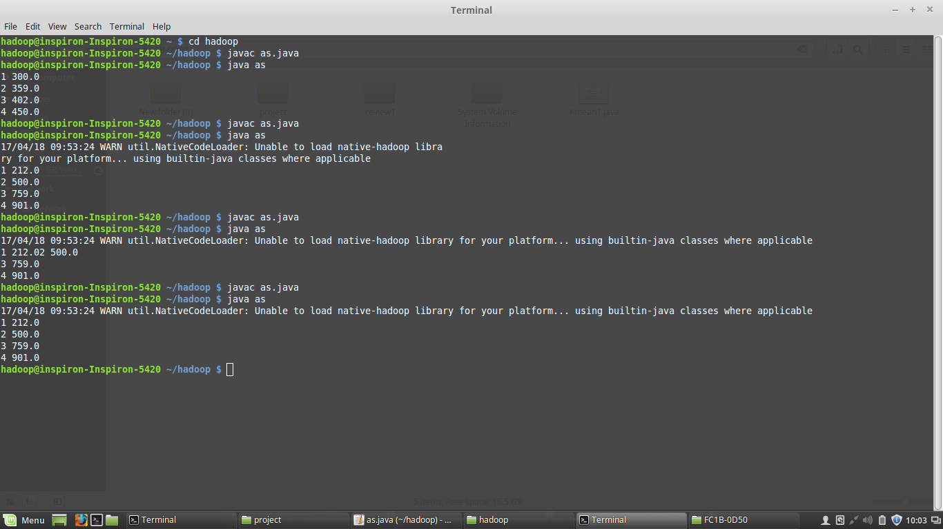
Input:
Data Points, τ1 (Neighbor Radius)
Output:
Cluster Centroids
Screen Shot:

Slide 19
K- means algorithm
Centroids from SDSCM are taken as inputs.
Distances between every data point and the centroids are calculated and stored.
Based on distance calculates, each point is assigned to the nearest cluster
New cluster centroid positions are updated: similar to finding a mean in the point locations
If the centroid locations changed, the process repeats from step 2, until the calculated new center stays the same, which signals that the clusters' members and centroids are now set

Slide 20
Input:
Data Points , Cluster Centroids
Output:
Clusters
Screen Shot:

Slide 21
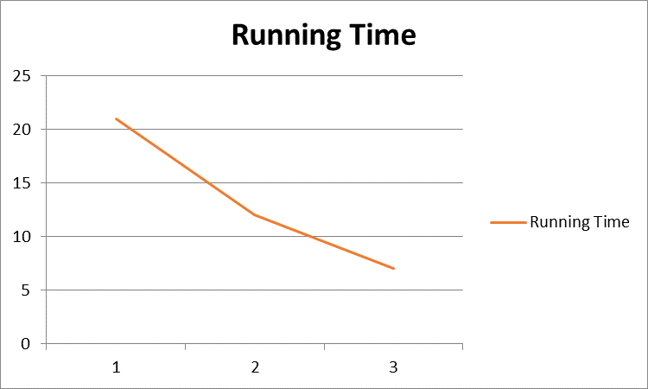
Performance Analysis:
Ratio test of SDSCM deployed on increasing number of nodes
Time taken for clustering in single node - 21 seconds
Time taken for clustering in two nodes - 12 seconds
Time taken for clustering in three nodes - 7 seconds
Running Time (seconds)
Number of nodes
Department of IT

Slide 22
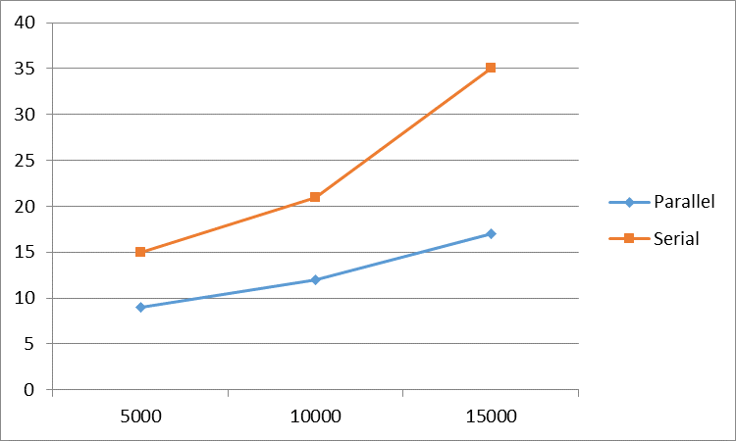
Running time of serial SDSCM and parallel SDSCM deployed on an increasing scale of data set
With increase in data size, the running time reduces proportionally if it is run in parallel.
Running Time (seconds)
Data size
Department of IT

Slide 23

Management Suggestions:
r – Response Rate
c – Retaining Cost
d – Discount rate
= c * *r
Churn Rate = d*
Department of IT

Slide 24
Conclusion:
To provide companies with effective methods to prevent churning customers in big data era, we first propose a new clustering method called SDSCM based on SCM and AFS.
SDSCM improves clustering accuracy of SCM and k-means.
To deal with industrial big data, a parallel SDSCM algorithm through a Hadoop Map Reduce framework improves efficiency.
Running time tremendously decreases when with increase in the number of nodes during parallel execution.

Slide 25
References:
A customer churn prediction model in telecom industry using boosting
Churn prediction in online games using players’ login records: A frequency analysis approach
K-means for parallel architectures using all preﬁx-sum sorting and updating steps
Large scale experimental evaluation of cluster representations for multi objective evolutionary clustering
Fuzzy clustering analysis based on AFS theory

